Slide 1
Python 4.01
Looping Basics

Slide 2
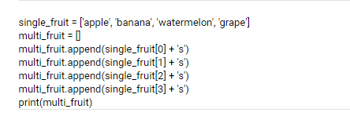
Looping Basics
What does this code do?
What would happen if the list got much larger?

Slide 3
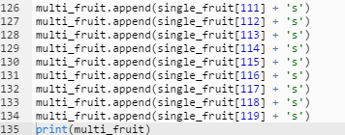
Looping Basics
That’s a lot of code, what could happen when writing that much code?

Slide 4

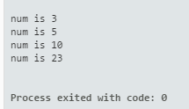
Looping Basics
This method seems a bit easier

Slide 5
Looping Basics
This method of iterating through an object like a list is called a
for loop

Slide 6
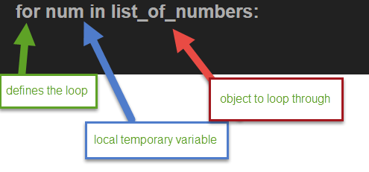
Looping Basics
for loop
Syntax
A for loop is a way to iterate through an object like a list or string.

Slide 7
Looping Basics
for loop
Syntax
The body of the for loop is indented to indicate what will be looped. In this example we are concatenating (joining) two strings.
We are joining the term “num is” with each number from the list.
The term num in this loop is a temporary variable that changes with each iteration of the loop.

Slide 8


Looping Basics
for loop
We can loop through objects other than lists too:

Slide 9
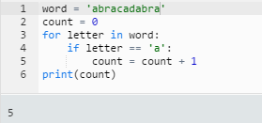
Looping Basics
for loop
We can use a for loop to count items in an object:
Here we counted how many times “a” appeared in a word.

Slide 10
Looping Basics
Lab 4.01
Complete Lab 4.01

